Slide 1

DriverPass System Analysis
Craig Rowell
Notes:
[No speaker notes required for this slide.]

Slide 2

System Requirements
Functional: The system shall provide a means for users to create an account and store the user’s credentials.
Functional: The system shall send push notifications as configured by the user.
Non-functional: Usability- The system shall be platform independent.
Non-functional: Reliability- The system shall track, display, and log student, instructor, and scheduling information.
Notes:
In order to properly describe the functionality and features of the DriverPass system, we have compiled a list of functional and non-functional requirements to use as a guideline during development. For functional examples, DriverPass will require an interface for users to enter their login credentials to access its services, such as scheduling practical driving instruction. When a user books an appointment, the DriverPass system will require the user to confirm their appointment by sending a push notification via their preselected contact method. It will also send push notifications to the user’s assigned instructor.
Examples of non-functional requirements include requiring DriverPass to be developed as platform independent, so that is usable by any user with a device that can load a web page. Also, the system will keep a database with a log of student, instructor, and fleet assignment information when a student schedules an appointment. This will ensure that the site is reliable.

Slide 3
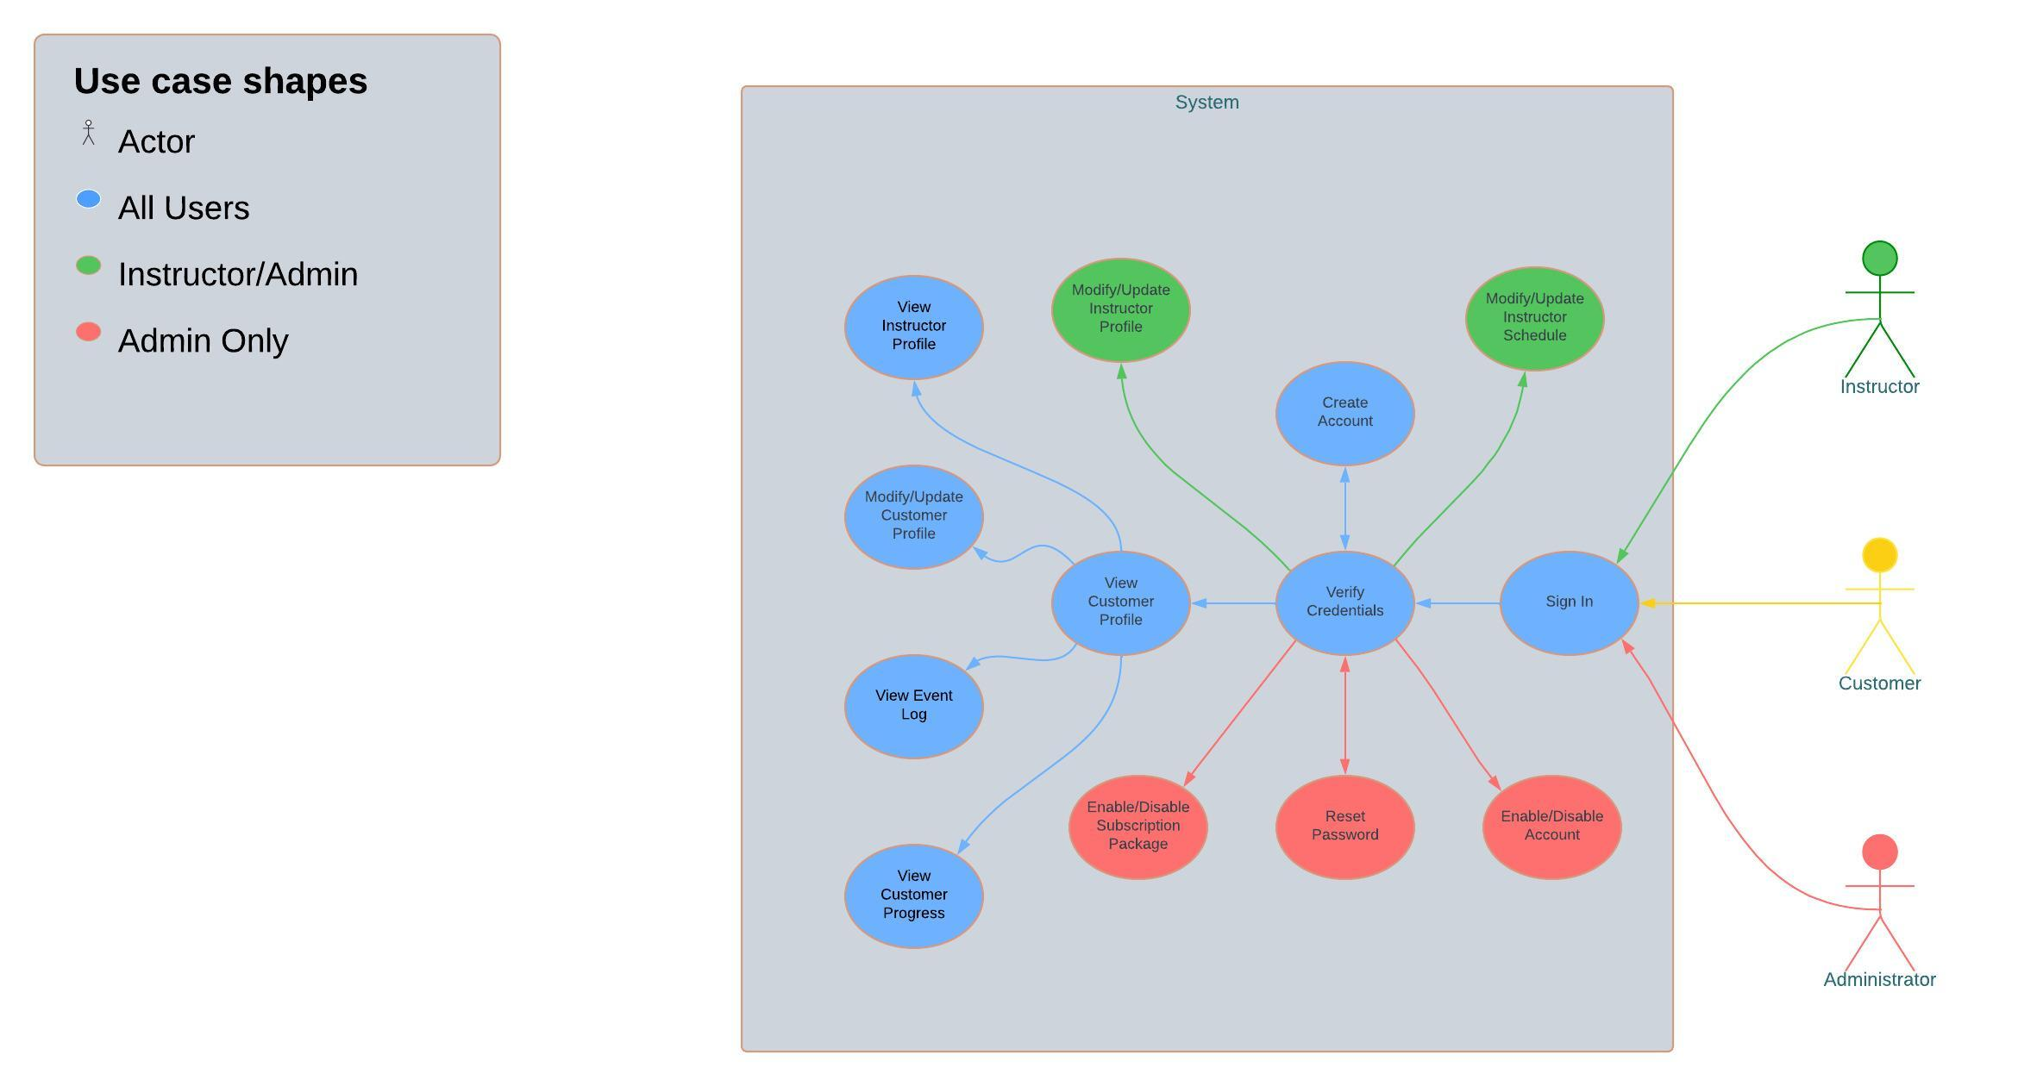
Use Case Diagram
Notes:
This use case diagram shows all the different ways users with different levels of access can utilize the system. The DriverPass system has been designed in a tiered structure. There are only three tiers in the system, administrators, instructors, and customers. Customers are the first tier. They can login with their verified credentials or create an account if they don’t already have one, view their profile once it is created, track their progress in practice tests for the written exam, view an event log for their practical instruction appointments, update their profile, as well as view their instructor’s profile.
Instructors are the second tier. They have access to all the functionality that a user does, but for each of their assigned students. In addition, they can update their instructor profile, and modify their practical instruction schedule as necessary.
The Administrator is the third tier. In addition to all the user and instructor features, an Admin can enable and disable Subscription packages, reset passwords, and disable inactive or delinquent accounts.

Slide 4
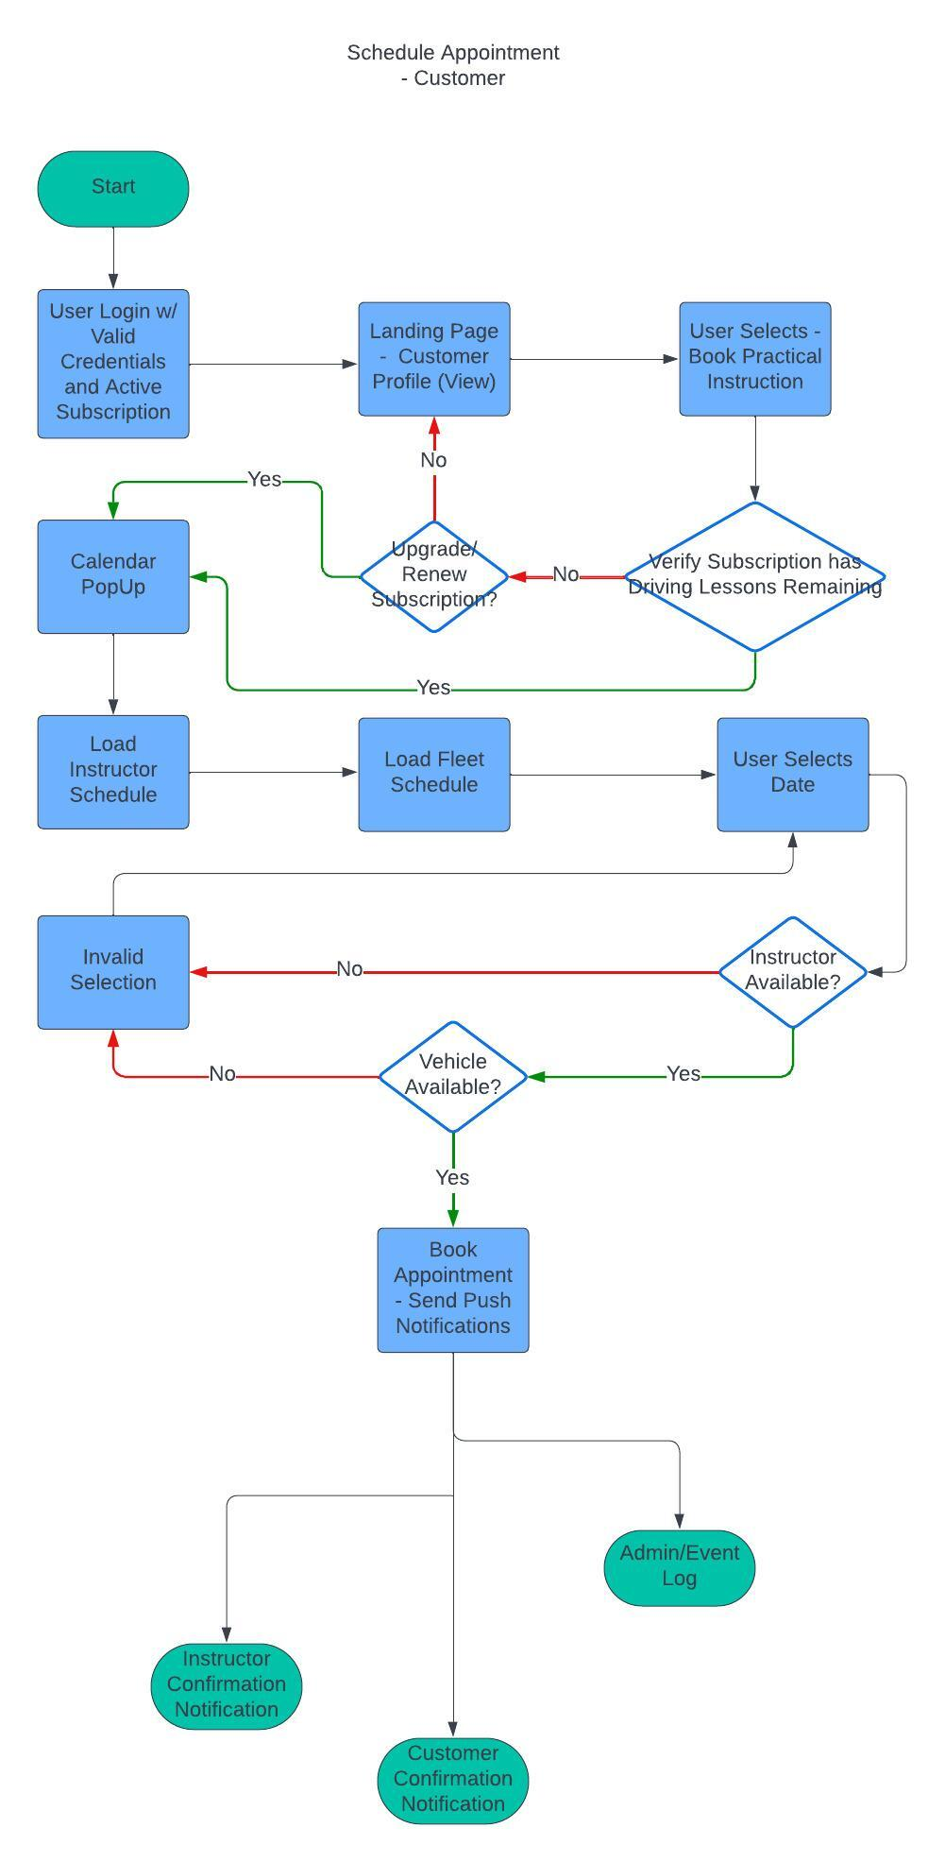
Activity Diagram
Notes:
[Explain your diagram. Which use case are you breaking down? What are the steps for this use case? How did you account for DriverPass’s needs in your design? In your explanation, keep your audience in mind. Avoid the use of technical terms such as “nodes,” “control flows,” and so on.]Here is an example of the workflow for the Customer Appointment Scheduling feature. Once the user has successfully logged in, they will be directed to their profile’s landing page, the main menu for the website. From there, they can click a link which displays a popup overlay scheduling page which contains a calendar populated with their instructor’s availability, and the vehicle fleet availability. Unavailable times will be blocked out and un-selectable, but the system will still verify that the resources are still available for the selected timeslot during the selection confirmation to prevent synchronous double-booking. If the timeslot is still available, the appointment will be logged in the Event log database used to display availability, and push notifications will be sent to the instructor and customer.

Slide 5
Security
The system shall require two-factor authentication to confirm user identity.
The system shall use HTTPS web protocol so that sensitive user information is encrypted.
Notes:
Two-factor authentication requires the user to select a form of contact, either email or a mobile number where they will be sent a text code to be entered upon account creation, and during password reset. This will ensure the users are who they say they are and prevent identity theft. Because users will be sending sensitive information such as credit card numbers, the website will need to use encrypted HTTPS protocol to prevent hackers from stealing their data.

Slide 6
System Limitations
Internet Access is required to access the system
Cloud storage could become corrupted, so a backup method for storing databases will be necessary.
Notes:
Because the DriverPass platform is a website, users who don’t have an internet or mobile data connection will be unable to use the service until their data is restored. Because the website will be utilizing cloud technology, a physical backup system should be in place to prevent the loss of stored information in the event the cloud becomes corrupted or inaccessible.

